Slide 1
Le Traumatisme et Ses Effets Sur L’Apprenant
Trauma and Its Effects on Learning
Le Conseil Scolaire des Premières Nations en Éducation des Adultes
The First Nations Adult Education School Council
Suzy Goodleaf M.Ed
Psychologist, OPQ

Slide 2
Creating Awareness
Because Sometimes …..
We Don’t Know,
What We Don’t Know

Slide 3
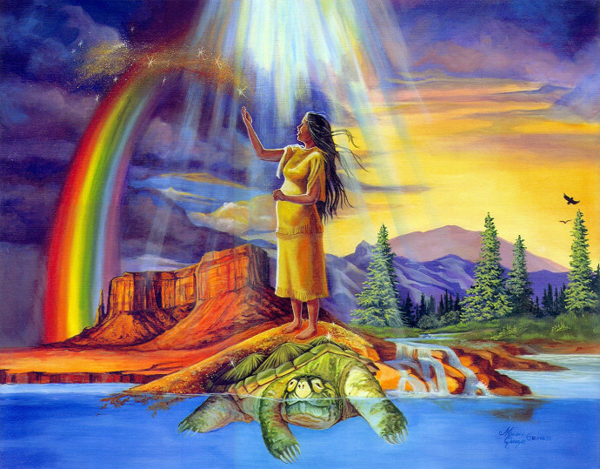
A Native Psychology Perspective
There is an interconnection between all living things and we experience the effects of each on the other
Physical, Emotion, Mental and Spirit work together to form a functioning entity.
There is an understanding that we are part of a bigger picture,
The spiritual will have an influence on the person’s psychological state
Indigenizing Psychology Symposium takes a Native worldview
/#content-header Author Barb Nahwegahbow; Windspeaker TORONTO Volume: 33 Issue: 4 Year: 2015 :

Slide 4
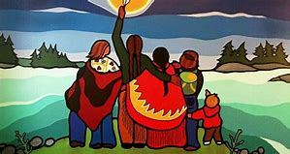
OUR FOUNDATION OF NORTH AMERICAN INDIGENOUS VALUES
Jane Middelton-Moz and Rebecca Martell
INCLUSION/BELONGING
COOPERATION
RESPECT
KINDNESS

Slide 5

Trauma Informed Schools
Trauma-Informed school staff understand the profound neurological, biological, psychological, and social effects of trauma and violence on children.
Notes:
During the school year children spend the same amount of time at school with teachers and peers as they do at home with their families. Students are not only expected to attend, focus and learn new info, but to also negotiate relationships with adults and peers and to regulate their emotions and behavior in specific ways. Few school staff understand the many ways that trauma affects children ‘s functioning at school, let alone specific techniques to teach traumatized children.

Slide 6
Impact of Trauma on School Performance
Decreased Reading Ability
Lower GPA
Higher Rate Of School Absences
Increased Drop-out
More Suspensions And Expulsions
Are 2 ½ Times More Likely To Fail A Grade
Score Lower On Standard Achievement Test Scores
Have More Receptive And Expressive Language Difficulties
Are Suspended And Expelled More Often
Are Evaluated For Special Education Services More Often
National Child Traumatic Stress Network

Slide 7
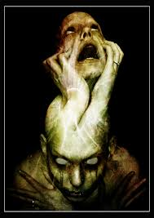
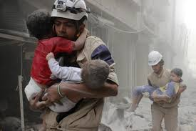
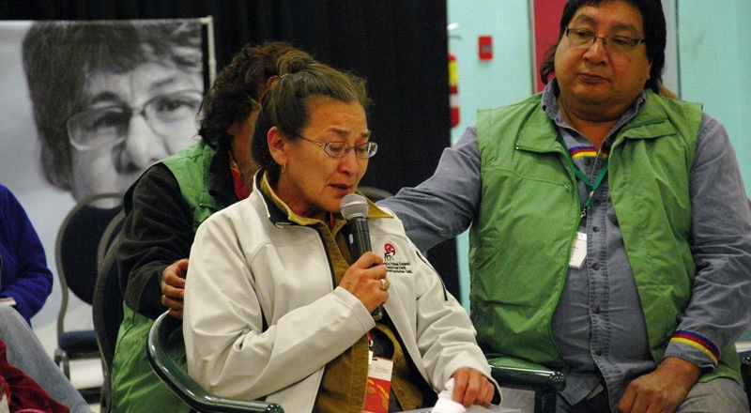
A TRAUMA REACTION IS A TRAUMA REACTION
WHETHER IT IS YOUR TRAUMA OR SOMEONE ELSE’S

Slide 8
Traumas
Personal Trauma
Historical Trauma
Multigenerational Trauma or Vicarious Trauma
Inter-generational Trauma

Slide 9
ACES
Scores increase with the number of score over 4
Adverse Childhood experiences across the life span.
Attempted Suicide
Injection Drug use
Illicit drug use
Depression
Chronic Bronchitis
50+ sex partners
Poor self care
Current Smoker
Cancer
Severe obesity
Emotional Abuse
Physical Abuse
Sexual Abuse
Neglect
Loss of Parent
Divorce
Mental Illness
Alcoholism
Incarceration
Family Violence

Slide 10
Mechanisms by which Adverse childhood experiences influence Health and Well-Being Throughout the life span.
Death
Early Death
Disease Disability and Social Problems
Adoption of Health-risk Behaviors
Social, Emotional, and Cognitive Impairment
Disturbed Neurodevelopment
Adverse Childhood Experiences
Conception

Slide 11
Royal Commission on Aboriginal People indicate that there are significantly higher rates of certain health issues for First Nations than other Canadians.
(OFIFC Mental Health Strategy September 2006)

Slide 12
Unthinkable
In Canada, there are currently 3 times more Aboriginal children in the child welfare system today than the number of children in attendance at the height of the residential schools in the 1940s
(Blackstock & amp; Trocmé, 2005; de Leeuw et al., 2010; Salmon, 2010)

Slide 13
The objective of the Canadian Legislation is to continue… (Duncan Campbell Scott Deputy Superintendent of Department of Indian Affairs 1913-1932)
Until they don’t know themselves
Until they hold their own relations down
Until they can’t remember
Until they fear responsibility
Until they won’t lead
Until they loathe their own
Until there is not one single Indian that has not been absorbed into the body politic of Canada and there is no Indian question.

Slide 14
Historical and Multigenerational Trauma

Slide 15
Trauma
CUTS US OFF FROM OURSELVES AND EACHOTHER

Slide 16
Trauma Informed Care helps to Change Perspective:
From
The child is the problem
To
The Child has a problem

Slide 17
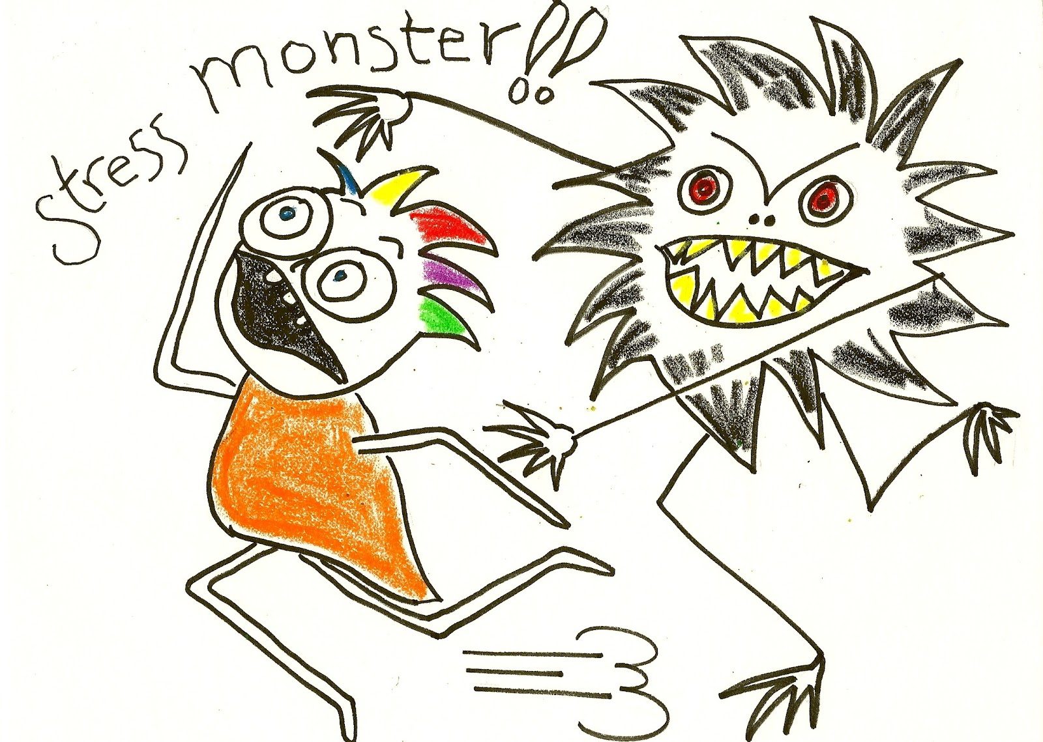
Drunk people… were more scary than the monsters in the dark
This refers not just to the compounding effects of multiple types of trauma and stressors on children’s lives, but to to the fact that trauma has a significant effect on the child’s developing brain systems.
( Geddes, 2019 Complex trauma .com)
This Photo by Unknown Author is licensed under CC BY

Slide 18
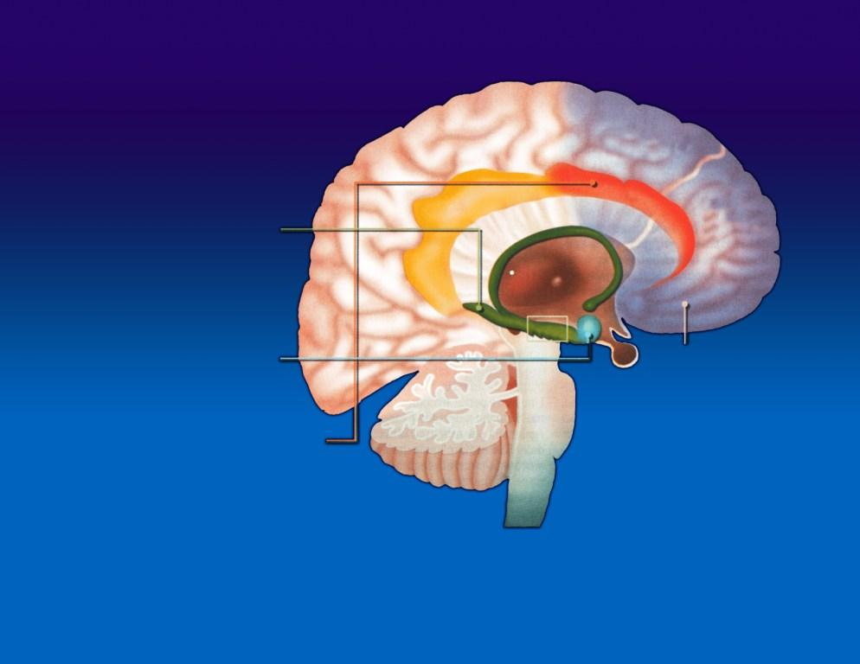
EMOTIONAL BRAIN
The Limbic System
The hippocampus regulates stress, helps with memorization and is a site of neurogenesis, which allows learning to take place.
The amygdala is involved in the generation of defensive/protective emotions (fear, aggressivity, etc.).
The prefrontal cortex is the seat of decision making and action.
The anterior cingulate cortex is the link between limbic structures (amygdala and hippocampus) and the prefrontal cortex.
From : Sciences et Avenir, February 2008
Notes:
Amygdalia: fight or flight dept (smoke detector of the brain) not logical
Hippo: info processor, logic and assessor
Cingulate: feedback or link between the two
Prefrontal: why am I doing this?

Slide 19
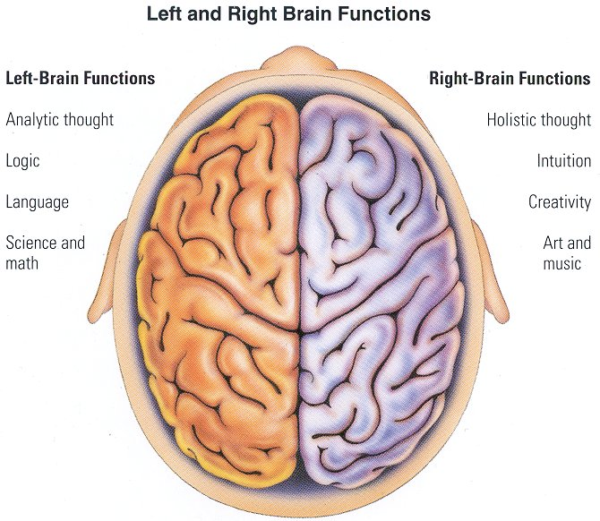
A Little Right-Brain Activity
Creative expression, music, art
Emotional expression
Non-Verbal communication:
  Eye contact
  Facial expressions
  Gestures
  Tone of voice(high-low)
  Posture
  Timing of speech/movement (fast-slow)
  Intensity of voice/movement(loud-soft)

Slide 20
A Little Right-Brain Activity
How little and not so little children read communication
Eye contact
Facial expressions
Gestures
Tone of voice(high-low)
Posture
Timing of speech/movement (fast-slow)
Intensity of voice/movement(loud-soft)

Slide 21
Left Brain Functions
Linear
Logical
Language based
Specializes in: Looking for cause and effect patterns
Using words to define the world
Right versus wrong thinking
Body image and awareness
Understanding others social cognition

Slide 22
The Hippocampus
Back part of the limbic system
Not mature (up and running) until 3-5 years
Supports the “response to stimulus”- gives meaning to the event in a linear fashion ( who /what/ where/ when/how?)
Suppressed during stress (effected by cortisol and adrenalin)
Closely connected to functions of the left cerebral cortex
Needs language for storage and recall ( Explicit memory)
Smaller than average in those who have experienced repeated trauma

Slide 23
How to help Traumatized Children
“Anything that helps to increase the quality and number of relationships in the child’s life.
  Stability
  Consistency
  Predictability
  Love
Bruce Perry

Slide 24
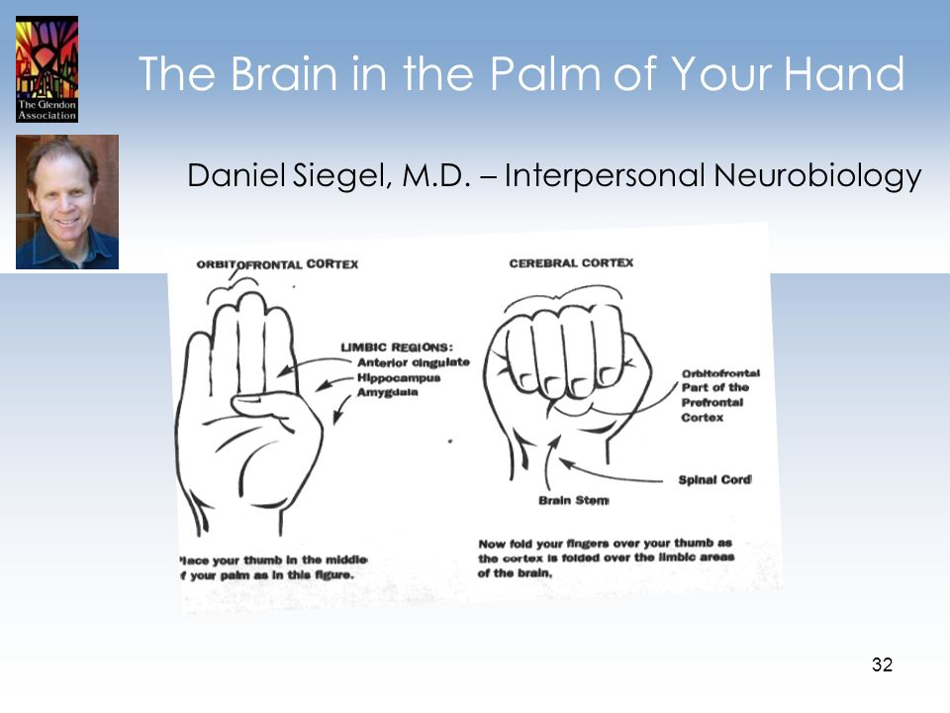

Slide 25
This causes a crisis in the individual’s human system: the brain accommodates and protects itself by splitting the information.
The cognition of memory of the event is contained in one component of the brain and the physical sensations and emotions are contained in another component.
Trauma

Slide 26
Trauma creates a block in communication

Slide 27
Autonomic Adaptation to a threatening world
Hyper arousal- Related Symptoms
Impulsivity; Risk taking; Poor judgment; Racing thoughts; Perceptual and muscular hyper vigilance; Post traumatic paranoia ; States of Frozen Terror; Intrusive images; sensations; emotions; Destructive and Addictive Behavior
Hyper arousal
OPTIMAL Arousal ZONE
Feelings can be tolerated; able to think and feel
Hypo arousal
Hypo arousal –Related symptoms; Flat affect; Numb;
Feels dead or empty;” not there” ; slow cognitive functioning; preoccupied with shame, despair and self-loathing; disabled defensive responses; victim identity
Ogden and Minton(2000);

Slide 28
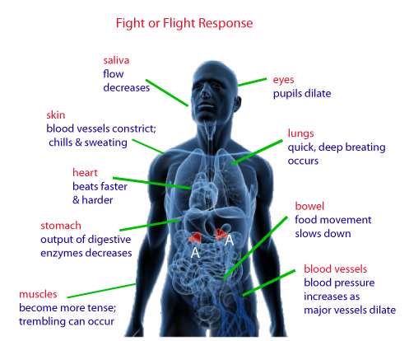

Slide 29
Working through the window of tolerance
https://www.youtube.com/watch?v=Wcm-1FBrDvU&t=102s

Slide 30
Trauma Informed Care helps to Change Perspective:
From
The child is the problem
To
The Child has a problem

Slide 31
“PROTECTIVE DEFIANCE”
                IS PROTECTING PERSONAL VULNERABILITY TO DECREASE THE RISK OF GETTING HURT

Slide 32
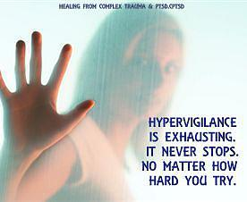

Slide 33
TEST
English:
What are cateclotamines?
Name 2 biological symptoms that arise as a result PTSD.
Which hormone secretion is associated with impulsivity and aggression?
French
Que distingue le stress aigu du stress chronique?
Quels sont les moyens offerts pour gérer son stress?
Comment la massothérapie contribue à la relaxation?

Slide 34
In your small group Debrief
First for yourself
What did you hear?
What did you see ?
How did it make you feel?
Discuss
How you think it feels to be that student?

Slide 35
Protective Defiance
Fight: “I’m not going to do what you say because you are saying it” talking back, actually fighting
Flight: Not showing up for class. Not following through with assignments or work.
Freeze: Not being able to talk or ask questions during the appointment. Not being able to do a presentation
Denial: is a tool of the unconscious to stay safe
  Minimizing
  Avoiding
  Blaming
Dissociation: Escape when there is no escape ; These students can blend into the walls
(Putnum 1977)

Slide 36
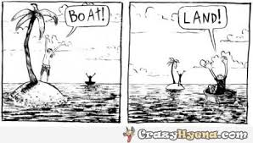
It’s About Perspective!

Slide 37
Trauma Informed Practice Is focused on: CONNECTION
Reframing our mindset ( what happened to you, not what's wrong with you)
Collaboration with the person not using power over them
No Blame
Choice
Breaking isolation creating mutuality
Empowerment
Incorporating Cultural Understanding
Trust worthiness
Power is shared

Slide 38
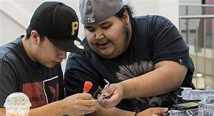
No significant learning Occurs without Significant Relationships: Rick Miller, Kidsathope.com
The more we learn about learning…the more we know it is about connection
Show me how
Be with me while I struggle
Do it with me
Celebrate my accomplishments
Challenge me to do better…and be better
Hold me accountable

Slide 39
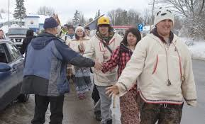
Resiliency in Action:
Nan Henderson, Editor with Bonnie Benard & Nancy Sharpe-Light
Communicate a resiliency attitude
Adopt a strength based approach
Provide opportunities for meaningful contributions to others
Increase positive bonds and connections
Set and maintain clear boundaries
Develop Needed life skills
Give it Time

Slide 40

And Gramma said…
“The key to success for anybody’s life be it human, animal, or bird is this….If you wanna have health and good life, you must make that person, that thing, feel important and wanted. And they will grow, and will have health and they will have success.”
…Iroquois Teachings
Tom Porter Sakokwenioskwas

Slide 41
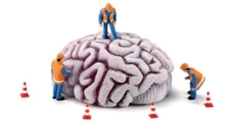
Youth The Remodeling Period of the Brain
Daniel Seigel Brainstorm 2015
Creative Exploration
Emotional
Spark
Novelty
Social
Engagement

Slide 42
Emotional Spark
Flood of feelings related to the onset of puberty and drive to remodel the brain
  +ve Passion / Life is fire
  Challenge: Emotional deregulation and moodiness

Slide 43
Social Engagement
There is a drive to move away from parents and move towards Peers
  +ve: Development of Social skills and collaborative functioning_
  -ve Peer Pressure ( sacrifice morality in favor of membership)

Slide 44
Novelty
Drive to try new things
  Brain chemicals change general decrease in dopamine,( low) But an increase in the surge during excitement.
Hyper rational thinking, focus on Excitement not Consequence
+ve Trying New things/ exploring
Challenge: Exposure to risk taking and danger

Slide 45
Creative Exploration
The brain is developing 3000 times faster than at any other time in life. It is pruning old information and making new strong connections; differentiating roles and integrating new information from all parts of the body and brain.
+ve Creating New Possibilities of seeing the Word
Challenge: A loss of innocents

Slide 46

Thank you,
Nia:wen
Meguitch
Merci!

